Slide 1
ST-Data Science
CSIT at UDC
Michael Travers

Slide 2
Diabetes Prediction

Slide 3
Introduction
Diabetes is one of the most prevalent chronic diseases in the United States
Affects millions and a financial burden on health care system
Early diagnosis is crucial for enabling timely lifestyle modifications and medical interventions to reduce severe complications for not just diabetes but also heart disease, vision loss and kidney failure

Slide 4
Introduction
This research aims to determine the most effective classification method, contributing to improved predictive analytics in healthcare.
The models to be compared include Support Vector Machine (SVM), Decision Trees, Linear Regression, Neural Networks, which detect complex patterns through layered computation.
This study utilizes a Kaggle dataset from 2025, comprising 100000 participants and 12 health-related features, including chronic conditions and preventive measures, to compare various machine learning models for diabetes prediction.

Slide 5
Objective
Develop and compare machine learning models to determine the most accurate and efficient classification method for diabetes prediction using a large-scale health dataset.
Analyze the impact of key health-related features on diabetes occurrence by leveraging predictive modeling techniques, aiding in early diagnosis and preventive healthcare strategies.
Enhance public health decision-making by identifying the most effective machine learning approach for risk assessment, contributing to improved diabetes management and resource allocation.

Slide 6
What is diabetes
Diabetes refers to a group of conditions characterized by a high level of blood glucose/blood sugar.which can cause serious or fatal health problems
As carbohydrates break down into glucose that is carried by the blood stream to various organs in the body.
beta cells in the pancreas produce insulin, insulin binds to its receptors on target cells and induces glucose intake
Insulin is a hormone produced by beta cells of the pancreas and is neassary for glucose intake by the target cells
Diabetes occur when the pancreas is not producing enough insulin or there is

Slide 7
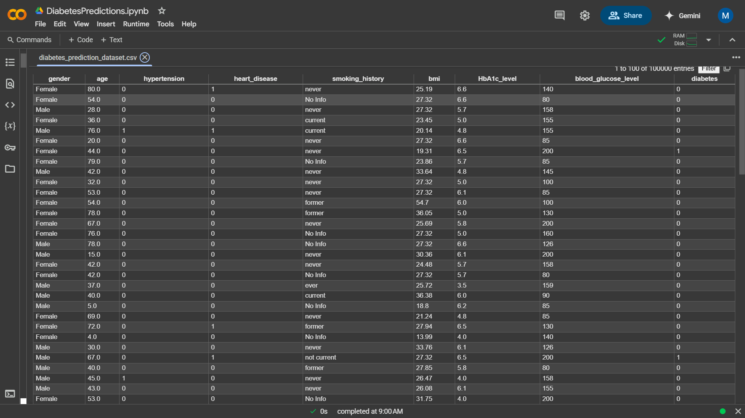
Dataset
This dataset is from a study in 2025 that containing a total of 10000 participates
Diabetes risk factors and associated health metrics includes: Gender, Age, Hypertension, Heart disease, Smoking History, BMI, HbA1c, Glucose level, and diabetes

Slide 8
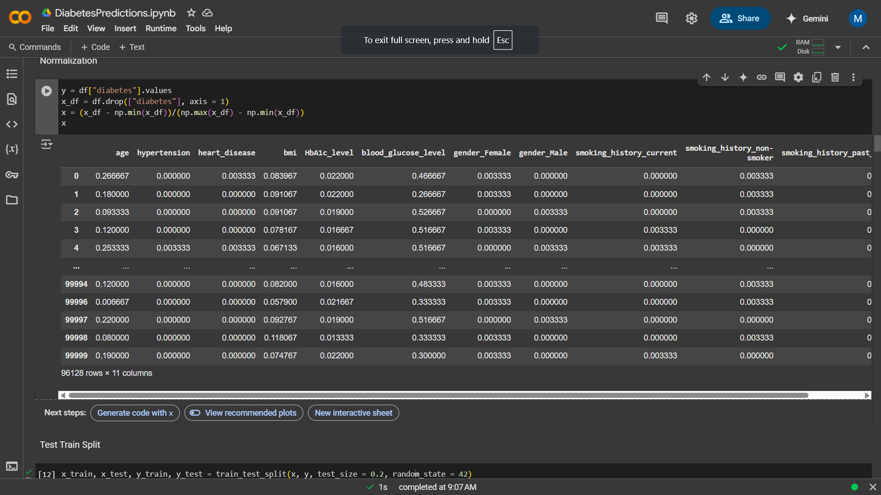
Pre Processing
Data Cleaning
Handle missing values using imputation techniques or removal strategies.
Remove duplicates and irrelevant entries.
Normalization
Scale numerical features to standard ranges
Ensures fair comparison among features during model training.

Slide 10
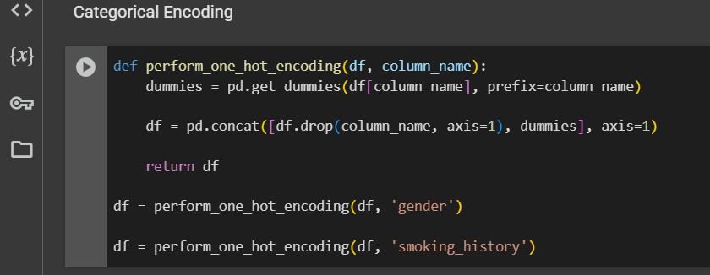
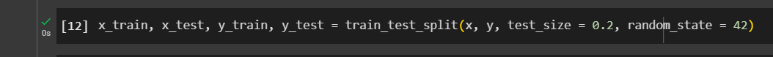
Pre Processing
Categorical Encoding
Convert categorical variables using One-Hot Encoding or Label Encoding.
Makes features machine-readable and suitable for modeling.
Feature Selection
Use statistical and model-based techniques
Identify the most relevant predictors of diabetes.
Train-Test Split
Split the dataset into training and testing subsets
Ensures reliable evaluation of model performance.

Slide 11
Methodologies
Data Preprocessing and Feature: The Kaggle dataset will be cleaned and prepared by handling missing values, normalizing numerical features, and encoding categorical variables. Feature selection techniques will be applied to identify the most relevant health-related factors influencing diabetes prediction.
Model Implementation and Training: Various machine learning models, including Support Vector Machine (SVM), Decision Trees, Linear Regression, Decision Trees and Random Forest tree, will be implemented and trained on the dataset. Hyperparameter tuning and cross-validation will be conducted to optimize performance.
Model Evaluation and Comparison: The trained models will be assessed using performance metrics (accuracy, recall and precision). A comparative analysis will be conducted to determine the most effective model for diabetes classification, providing insights for future healthcare applications

Slide 12
Models
Support Vector Machine (SVM) can be used find the optimal hyperplane to separate diabetic and non-diabetic individuals, maximizing classification margin.
Decision Trees will organizes data through a hierarchical structure, allowing for intuitive and interpretable classification decisions.
Linear Regression models the relationship between input features and diabetes occurrence by fitting a line through data points, useful when a linear correlation exists.
KNeighborsClassifier will finds the most similar past patients and predicts the same outcome (diabetic or not).
Random Forest Tree will learns complex relationships between features (e.g., insulin levels, glucose) and diabetes risk.

Slide 13
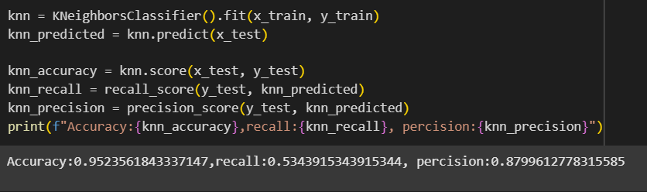
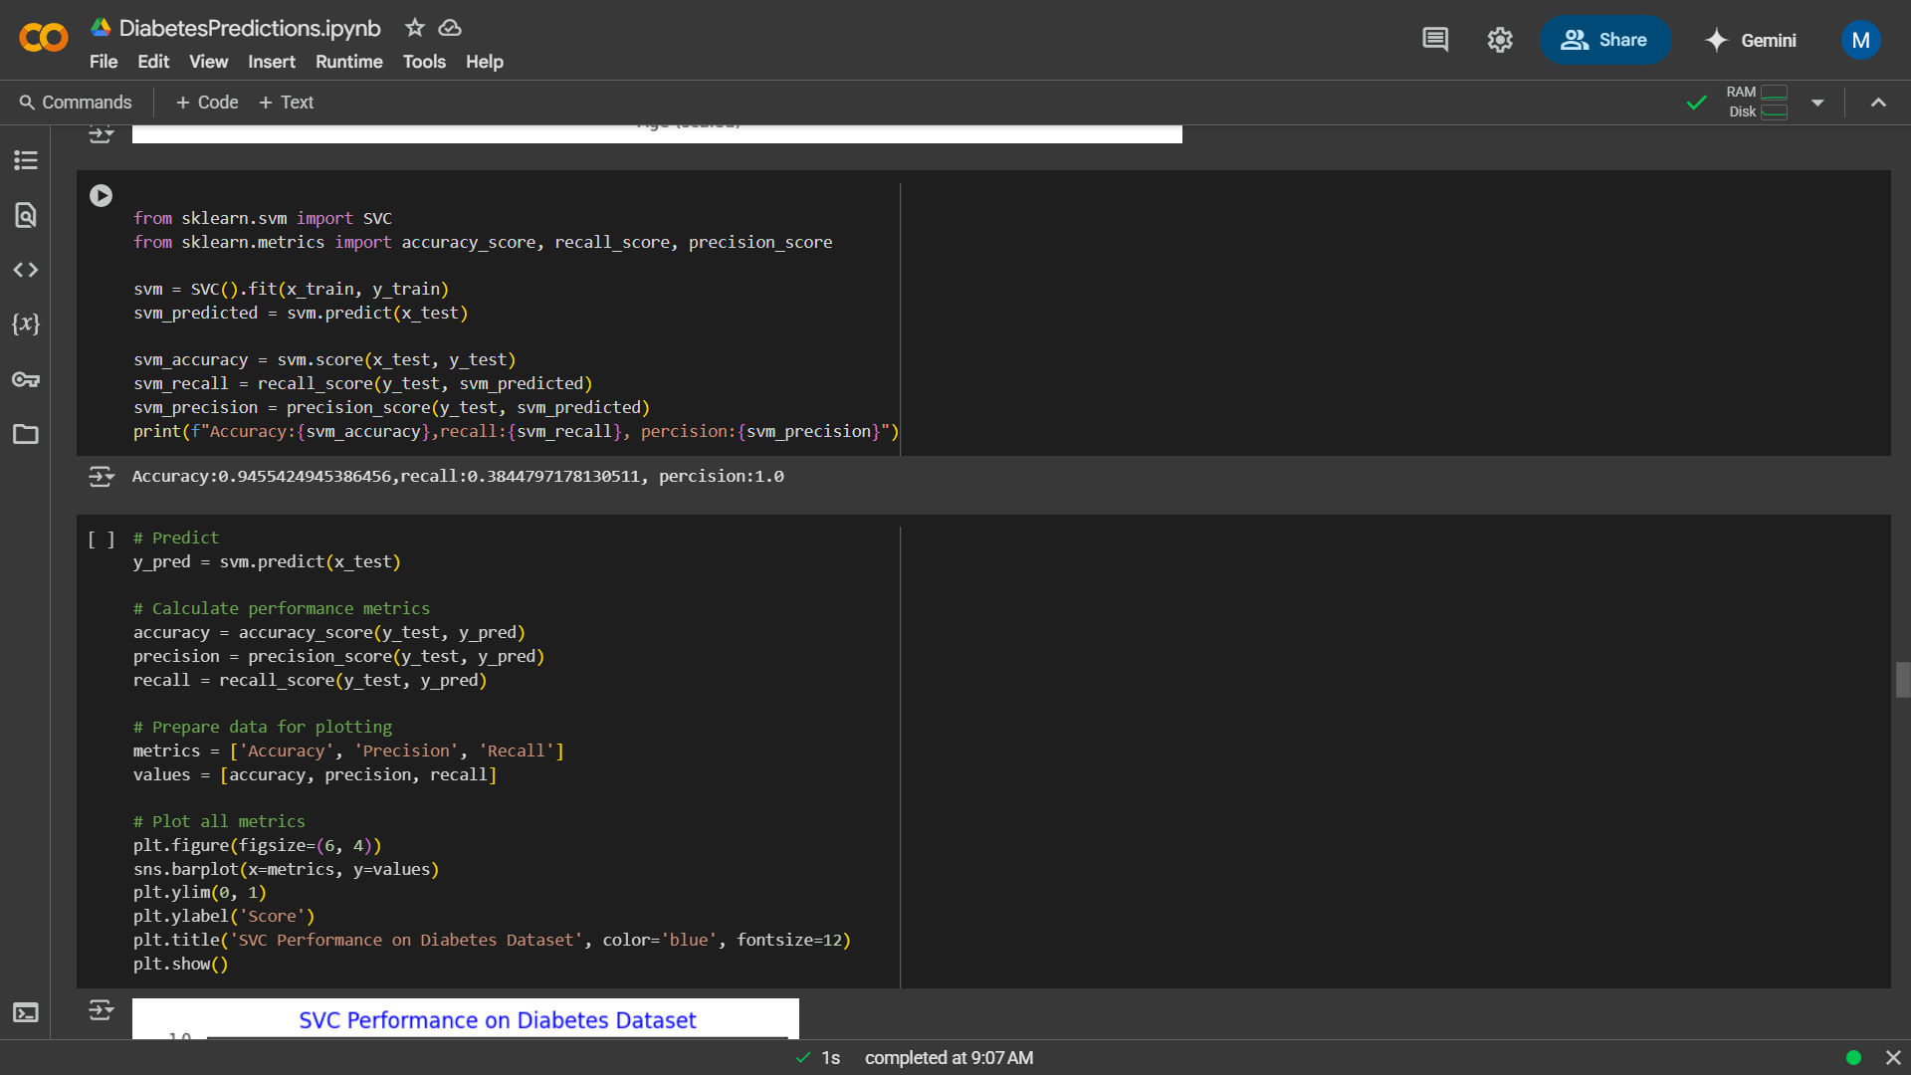
KNeighbors, SVC
KNeighborsClassifier achieves high accuracy (0.95) and precision (0.87), its classifies most instances correctly and reliably predicts diabetes when it does, but the low recall (0.53) indicates that many diabetic cases are missed and may struggle with identifying all patients who have diabetes.’
SVC has high accuracy (95%) and precision (1.0), but low recall (0.38), indicating it misses a significant number of diabetic patients (false negatives).

Slide 14
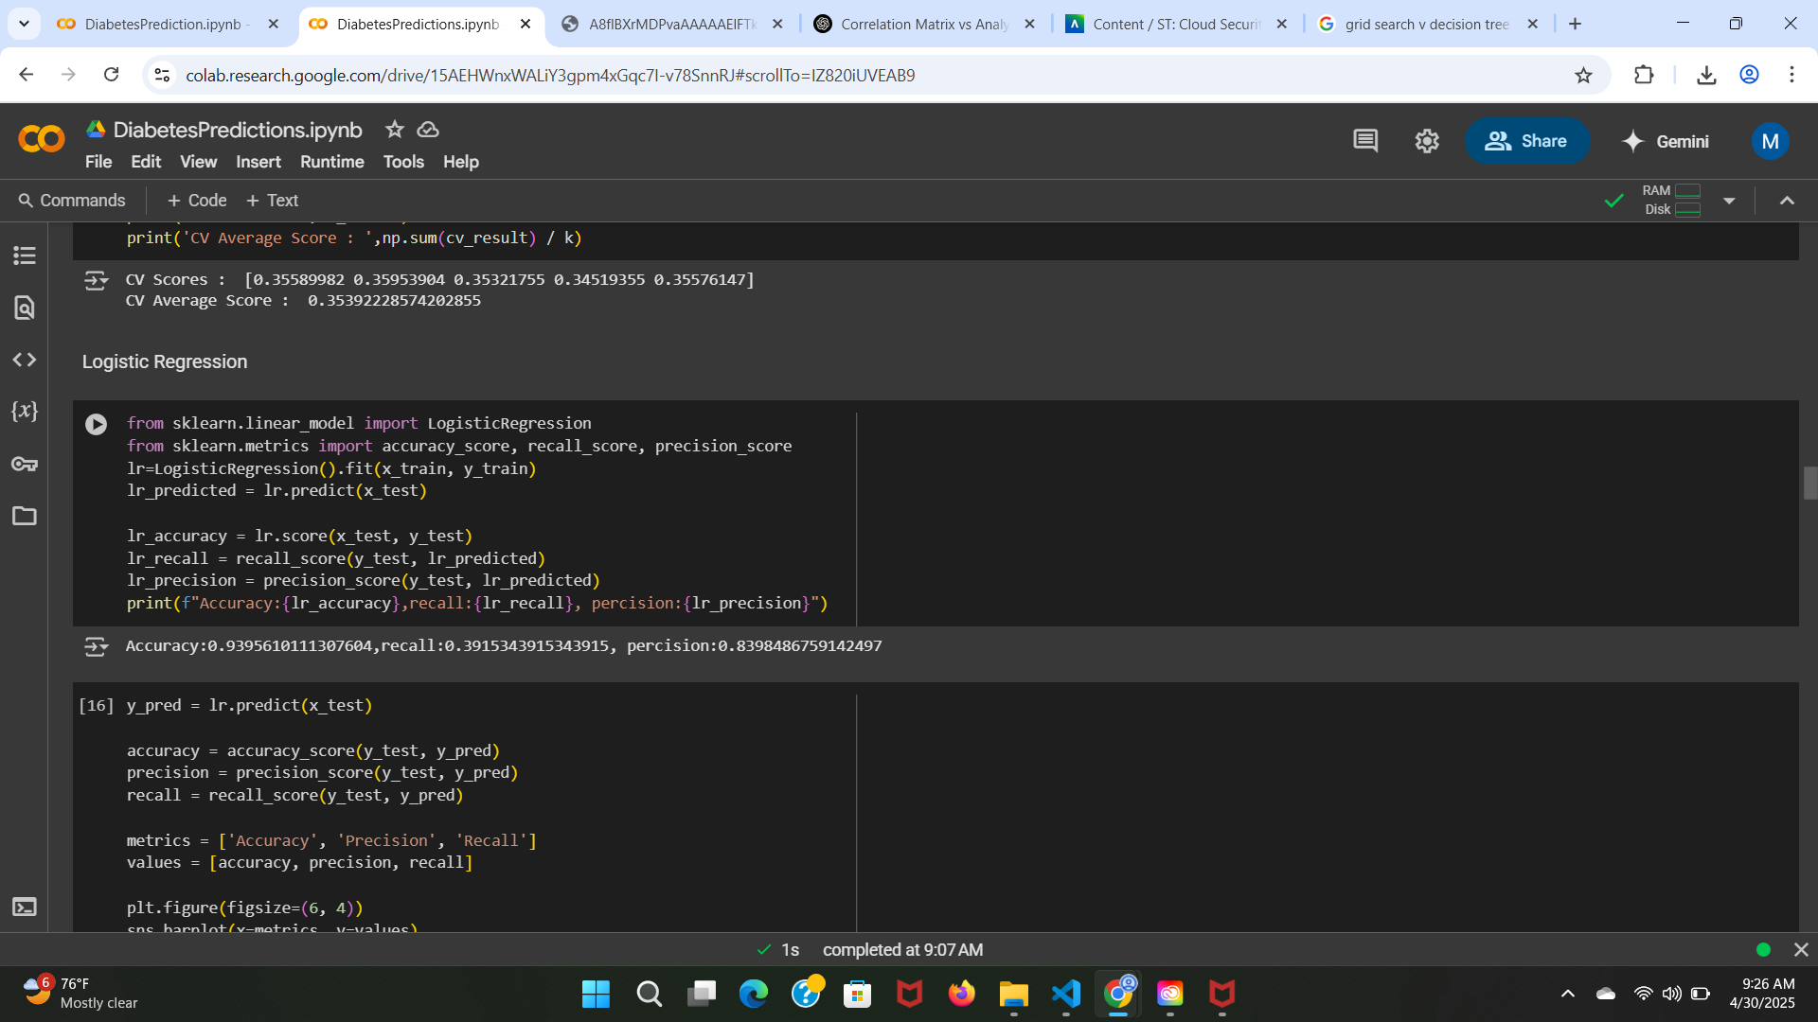
Logistic Regression
Logistic Regression shows high accuracy (0.93) and precision (0.83), indicating it correctly classifies non-diabetic patients and has a good rate of correctly identifying positive cases, but struggles with a low recall (0.39), meaning it misses many diabetic patients.

Slide 15
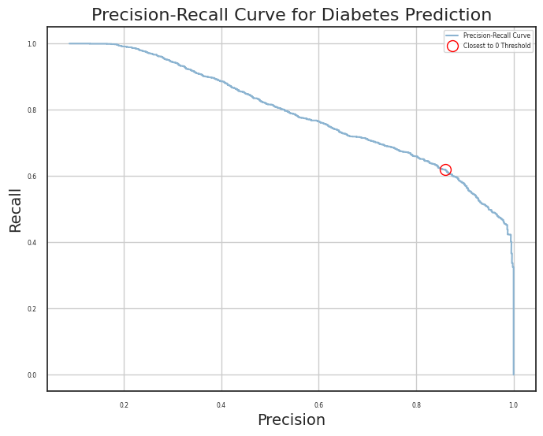
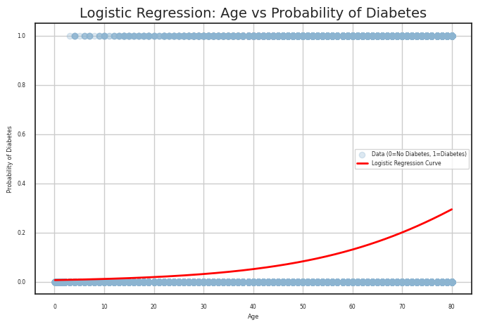
Logistic regression

Slide 16
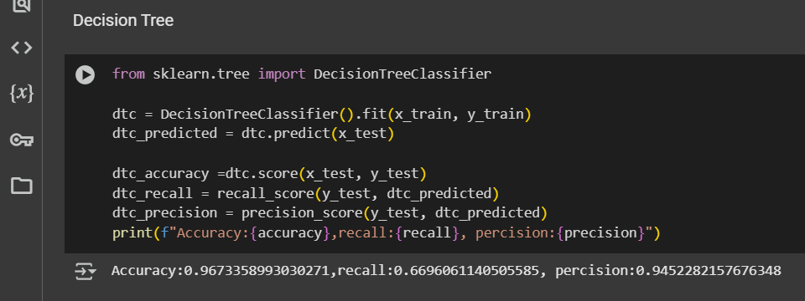
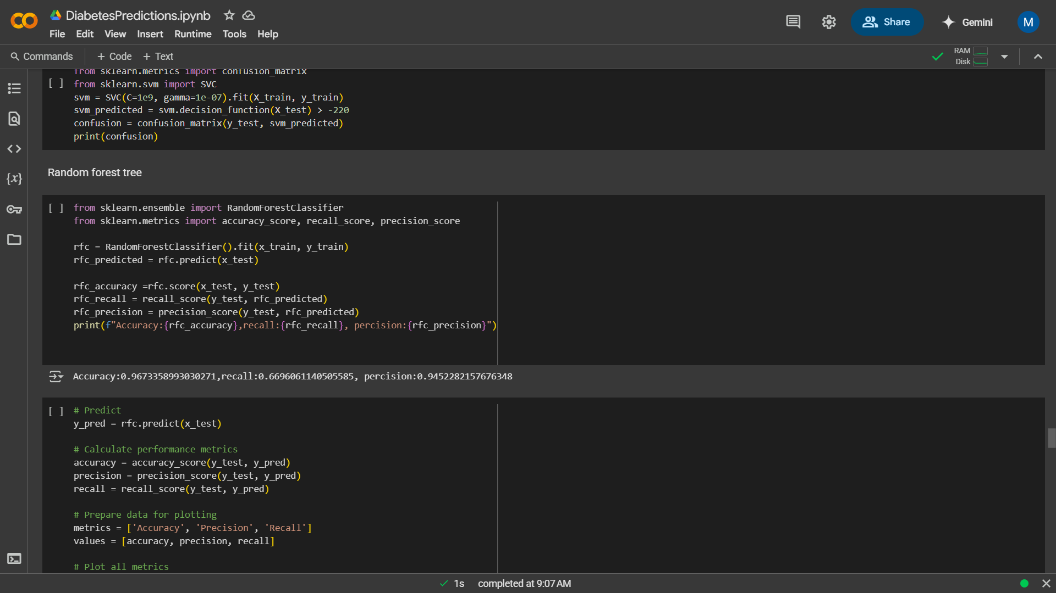
Random Forest Classifier, Decision Tree
RFC has high precision (0.94) and accuracy (0.96), Its effective at identifying non-diabetic patients but has a lower recall (0.66), missing about 34% of diabetic cases.
The Decision Tree model achieved high accuracy (0.94), meaning it correctly predicted most diabetes cases overall.
However, with a precision of 0.69 and recall of 0.72, it shows room for improvement in correctly identifying and confirming diabetic patients.

Slide 17
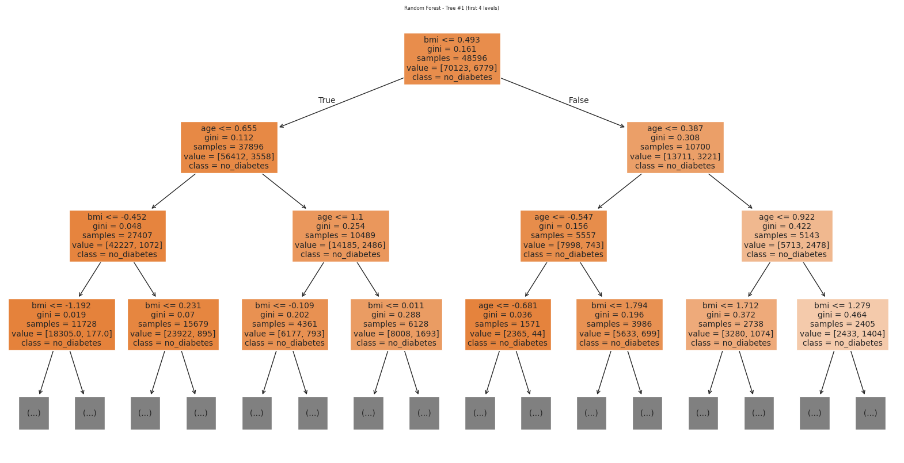
Random Forest
Feature Importance
4 HbA1c_level 0.664588
5 blood_glucose_level 0.319929
0 age 0.013587
3 bmi 0.001896
1 hypertension 0.000000
2 heart_disease 0.000000
6 gender_Female 0.000000
7 gender_Male 0.000000
8 smoking_history_current 0.000000
9 smoking_history_non-smoker 0.000000

Slide 18
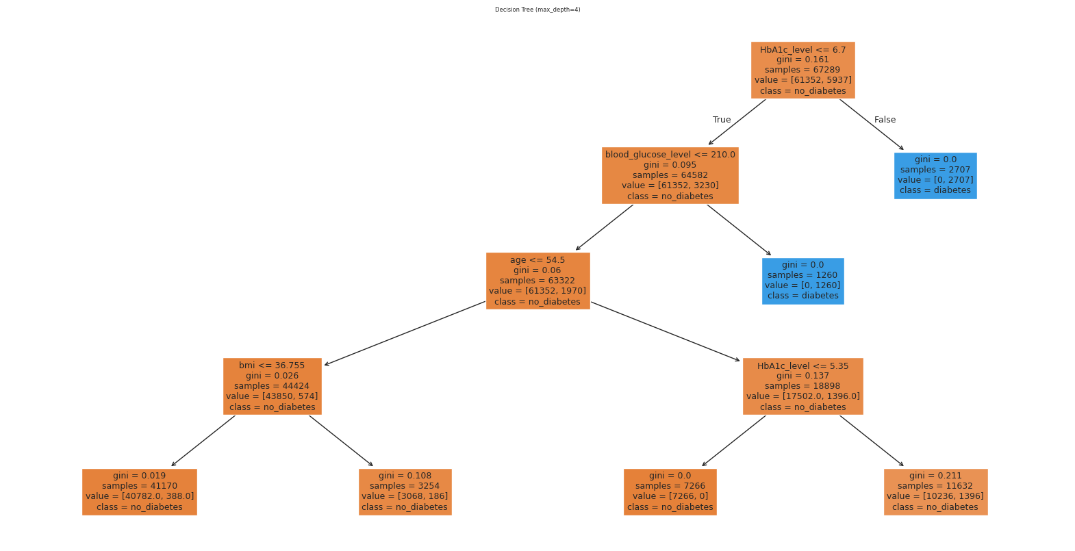
Decision Tree

Slide 19
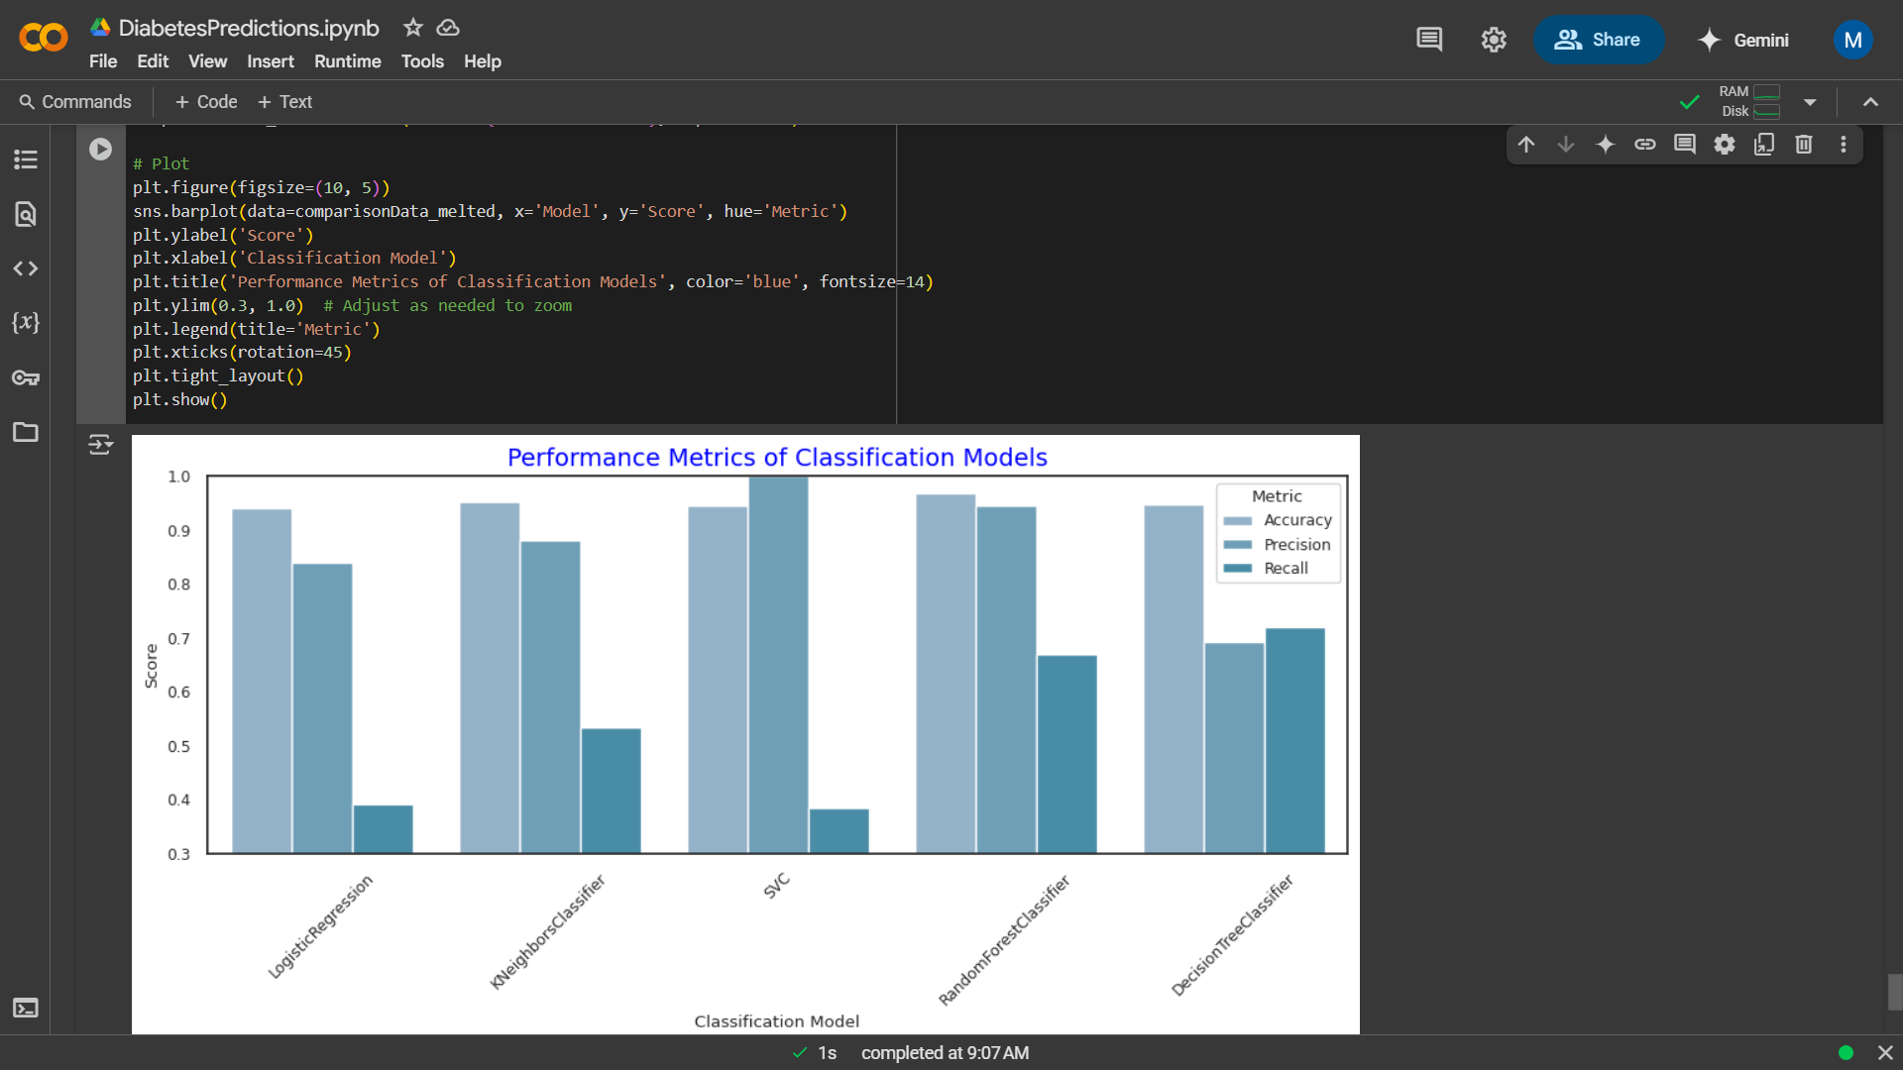
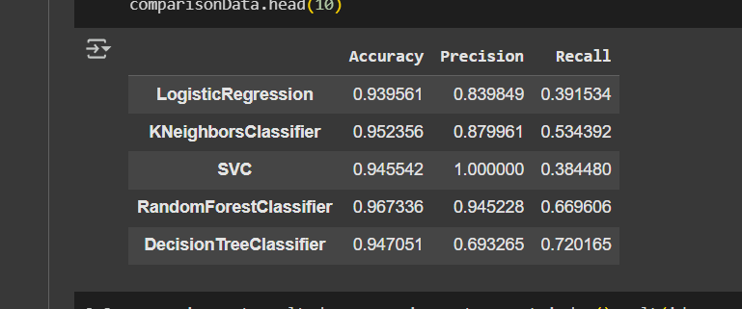
Results
Logistic Regression has high precision but low recall meaning it is good at not over predicting but misses many cases
K-Nearest Neighbors has a balanced and have a better recall than Logistic Regression
Support Vector has a perfect precision at 1 meaning every diabetes prediction was correct but low recall meaning it missed many cases
Random Forest has the best metrics for performance as its balanced catching diabetes cases
Decision Tree has a lower precision than Random Forest but a high recall

Slide 20
Future Findings
So when choosing a classification model for not just diabetes but other predictions it is advised to use Random Forest tree as its best and out performs other models as it is good for handling non-linear relationships leading to High accuracy, and handling of missing or dirty data.

Slide 21
The End

